Slide 1
Chapter V: MVC Model
Quyennv

Slide 2
QUESTIONS
What is MVC?
What is the primary advantages of MVC? (At least 2 main advantages)
Does a view allow users input?
Does a model allow users input or output?

Slide 3
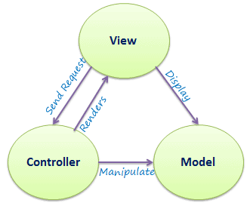
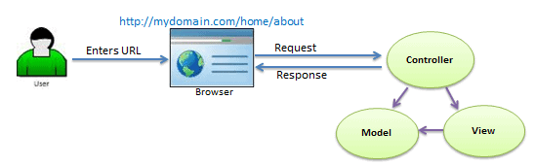
WHAT IS MVC?
MVC stands for Model, View, and Controller. MVC separates an application into three components - Model, View, and Controller.
Model represents the data
View is the User Interface.
Controller is the request handler.
Architecture
Request Flow

Slide 4
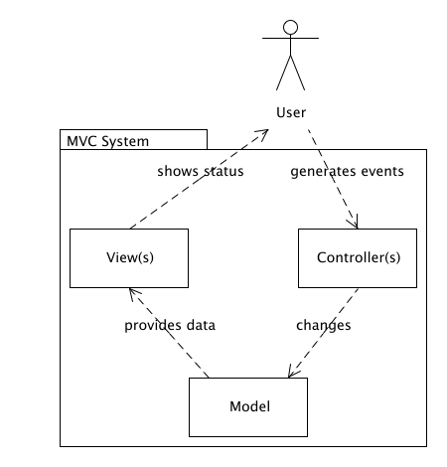
WHY MVC?
Separates representation of information from user interaction
Promotes:
Code Reusability => Faster and cheaper to develop an application
Easy for multiple developers to collaborate and work together
Easy to update the application
Easy to debug
Separation of Concerns

Slide 5
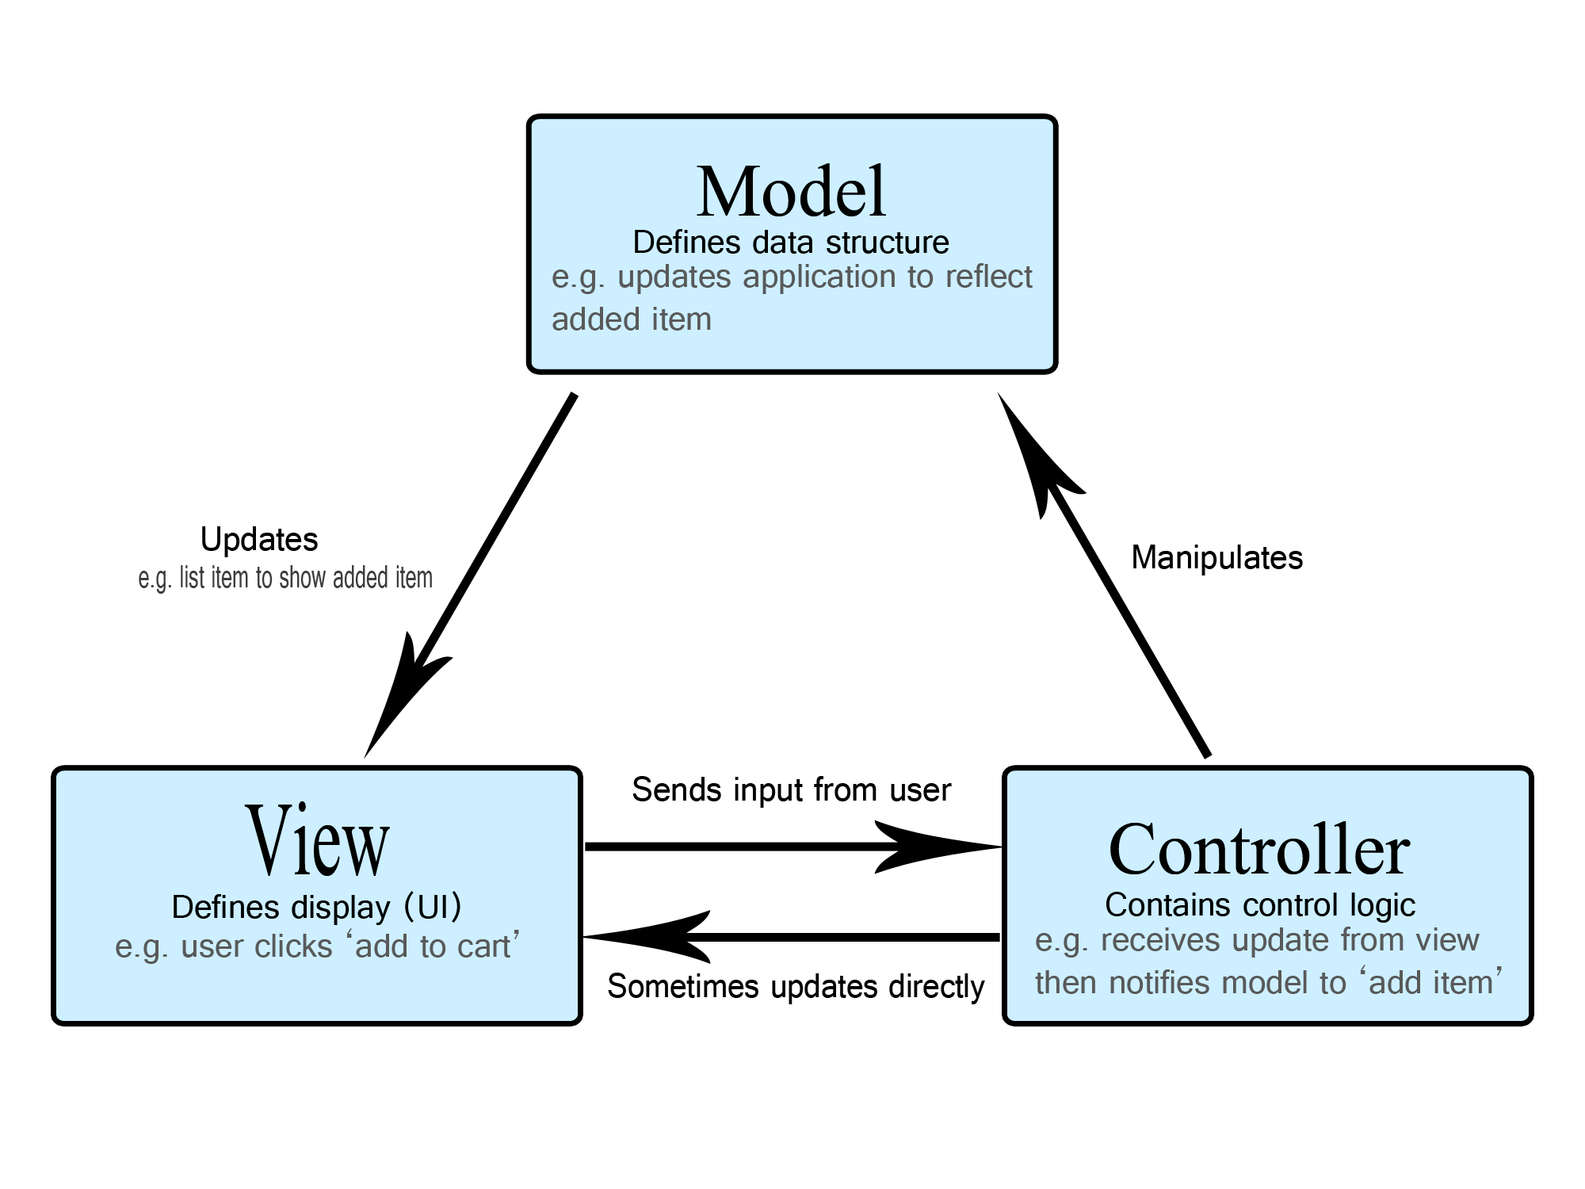
SOFTWARE ARCHITECTURE PATTERN

Slide 6
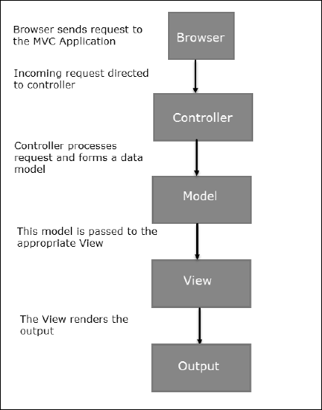
EXECUTION PROCESS
Controller – Mediates input and commands for the model or view
Model – Application data, business rules, logic, and functions.
View – Output and representation of data

Slide 7

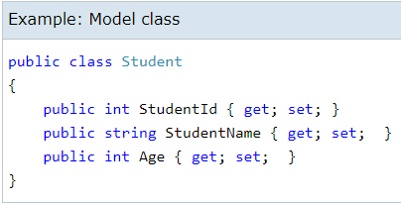
THE MODEL
The model classes represents domain-specific data and business logic in the MVC application. It represents the shape of the data as public properties and business logic as methods
The model should be independent of the controller and the view, however, provide services (methods) for them to use
Independence gives flexibility, robustness

Slide 8
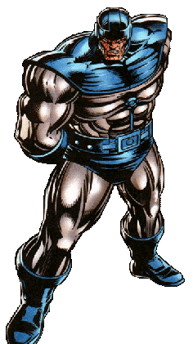

THE CONTROLLER

Slide 9
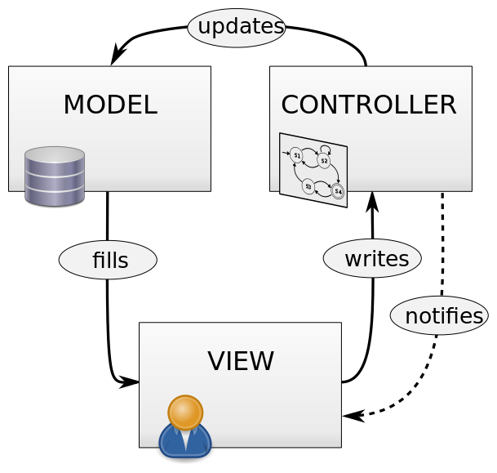
THE CONTROLLER
The controller provides model data to the view, and interprets user actions such as button clicks.
The design of the controller depends on the model, the model should not depend on the controller
Often, the user is put in control by means of a GUI

Slide 10
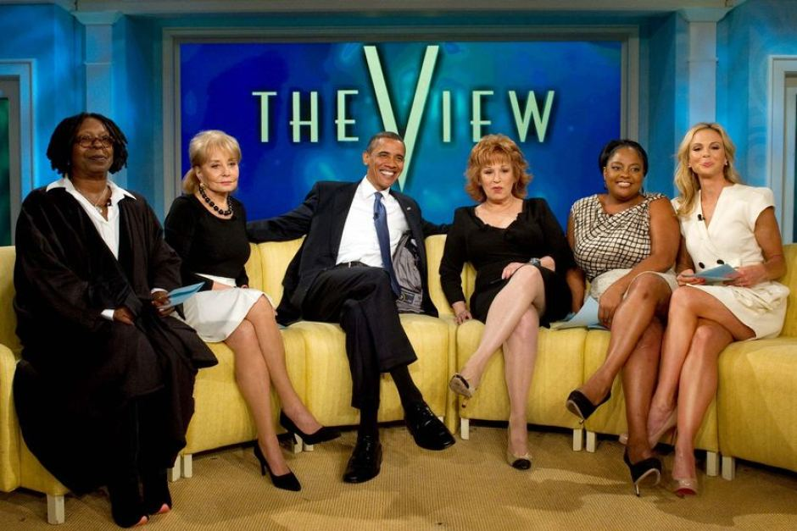
THE VIEW

Slide 11
THE VIEW
The view displays the model data, and sends user actions (e.g. button clicks) to the controller
In short, a controller can render one or more views. So, for easy maintenance, the MVC framework requires a separate sub-folder for each controller with the same name as a controller, under the Views folder

Slide 12
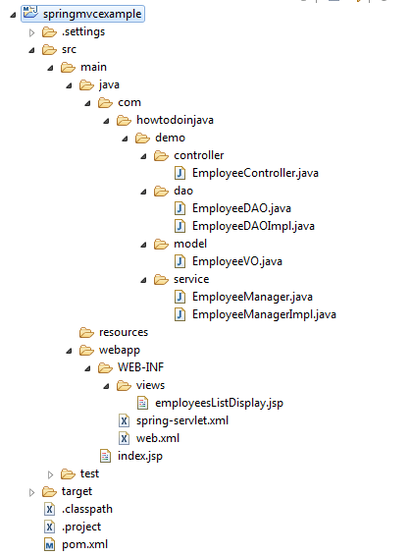
EXAMPLES

Slide 13
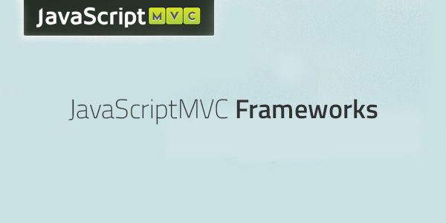


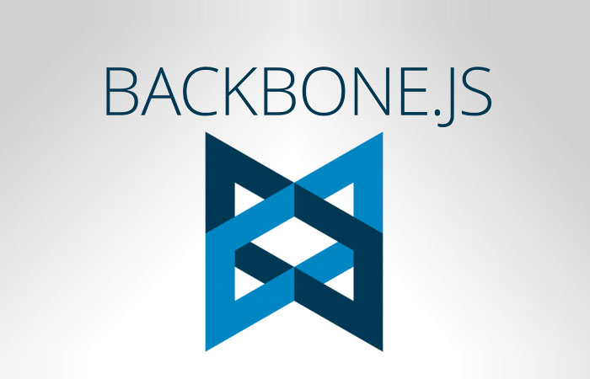
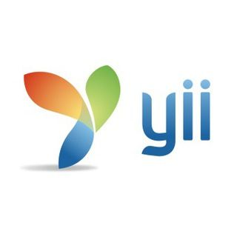

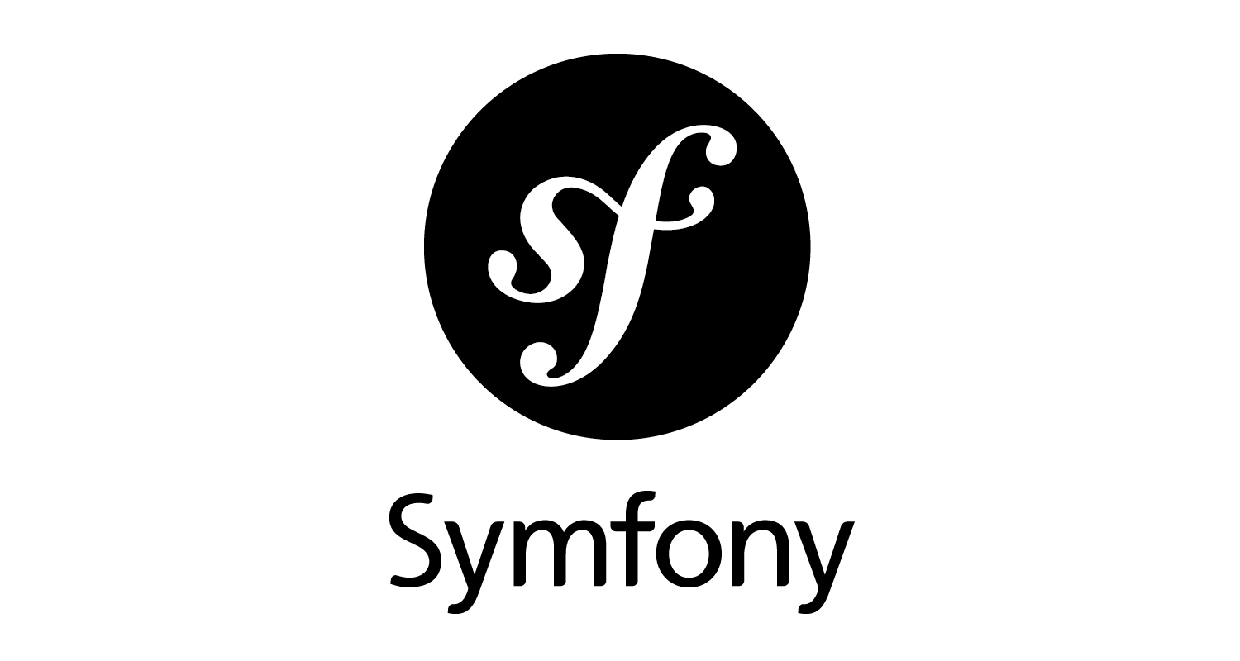
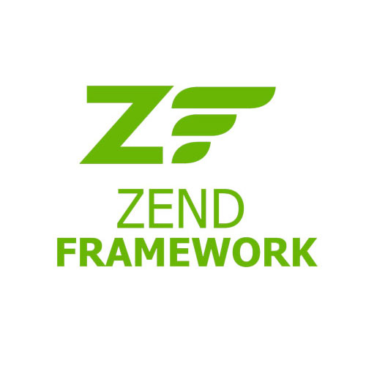

FRAMEWORKS

Slide 14
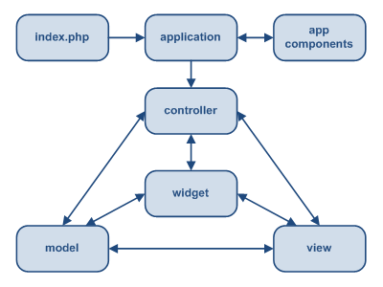
STATIC STRUCTURE OF YII APPLICATION

Slide 15
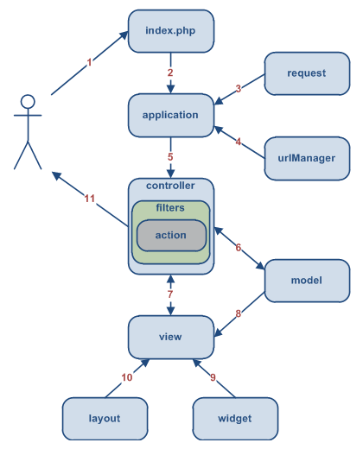
YII APPLICATION WORKFLOW

Slide 16
YII APPLICATION WORKFLOW
1. User makes a request with the URL http://www.example.com/index.php?r=post/show&id=1 and the Web server handles the request by executing the bootstrap script index.php.
The bootstrap script creates an Application instance and runs it.
The Application obtains detailed user request information from an application component named request.
The application determines the requested controller and action with the help of an application component named urlManager. For this example, the controller is post, which refers to the PostController class; and the action is show, whose actual meaning is determined by the controller.
The application creates an instance of the requested controller to further handle the user request. The controller determines that the action show refers to a method named actionShow in the controller class. It then creates and executes filters (e.g. access control, benchmarking) associated with this action. The action is executed if it is allowed by the filters.
The action reads a Post model whose ID is 1 from the database.
The action renders a view named show with the Post model.
The view reads and displays the attributes of the Post model.
The view executes some widgets.
The view rendering result is embedded in a layout.
The action completes the view rendering and displays the result to the user.

Slide 17
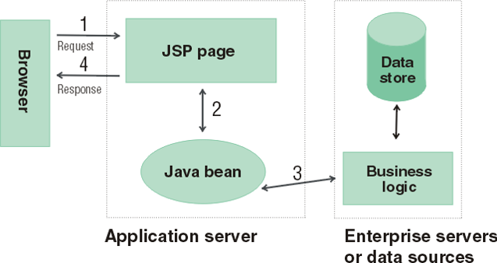
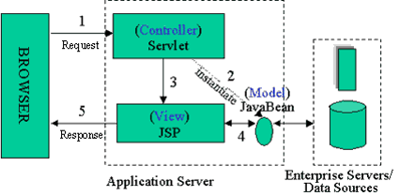
JAVA SERVER PAGES
Model: Enterprise Beans with data in the DBMS (Database Management System)
JavaBean: a class that encapsulates objects and can be displayed graphically
Controller: Servlets create beans, decide which JSP to return, do the bulk of the processing
View: The JSPs generated in the presentation layer (the browser)

